Slide 1

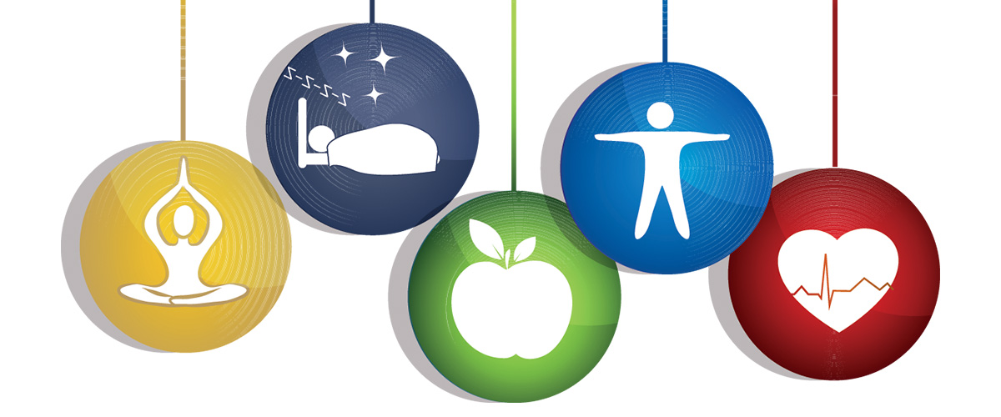
Project Guide:
Mrs. Sarika Khirid
Project By:
Mrudula Mutha
Mahesh Gurav
Nihal Maulavi
Statistical Analysis
on
Health of People

Slide 2
Introduction

Slide 3
Health is a state of complete physical, mental and social well being. Good health is central to handling stress and living a longer, more active life.
WHO defined health with a phrase that modern authorities still apply,
“Health is a state of complete physical, mental, and social well-being and not merely the absence of disease or infirmity.”
According to WHO, 60% of related factors to individual health and quality of life are correlated to lifestyle.
Hence we gave a thought to the lifestyle of people and its effect on their health. We chose this topic so to analyze what routines are affecting the health of a person.
By analyzing the data, we wished to make awareness about what factors have good or bad impact on health, and hence applying such a lifestyle that will improve the health.

Slide 4
Data Collection
Tools and
Techniques
Data Visualization
Data Analysis Techniques
Conclusions

Slide 5
Data Collection

Slide 6
Data is collected by taking information of a person using Google forms.
Information based on food, exercise, mental health, drinks, and daily routines is collected from each individual.
Dataset contains information of 398 individuals.
The target variables are:
Health/Fitness of a person (out of 5)
Happiness and Stress level of a person
Presence of any medical condition
Person has health insurance? (Yes/No)

Slide 7
Tools and Techniques

Slide 8
Tools used:
Python
R
Tableau
MS-Excel
Minitab
Statistical Techniques used:
Hypothesis Tests
Analysis of Variance(ANOVA)
Logistic/Linear Regression
Confusion matrix
Deep Neural Networks

Slide 9
Data Visualization

Slide 10
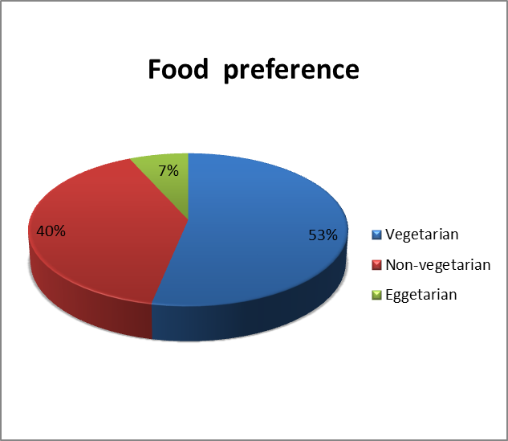
Comment :
We can clearly observe that the majority of people prefer Vegetarian food. Nearly, 40% people prefers Non-vegetarian food and remaining 7% people are Eggetarian.

Slide 11
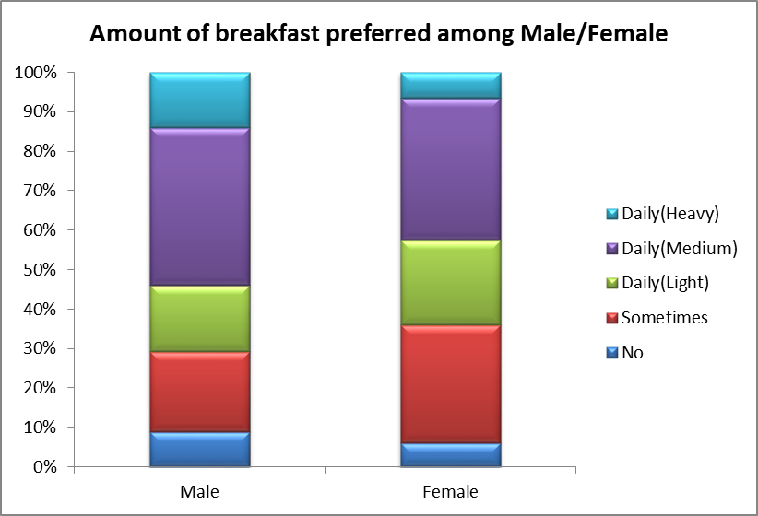
Comment :
We clearly observe that males and females both mostly prefers 'Daily(Medium)' type of breakfast.
People mostly prefers to have breakfast since percentage of people not having breakfast seems to be very low.
It seems that proportion of males having medium or heavy breakfast is more than that of females.
Proportion of females having breakfast sometimes is more than that of males.

Slide 12
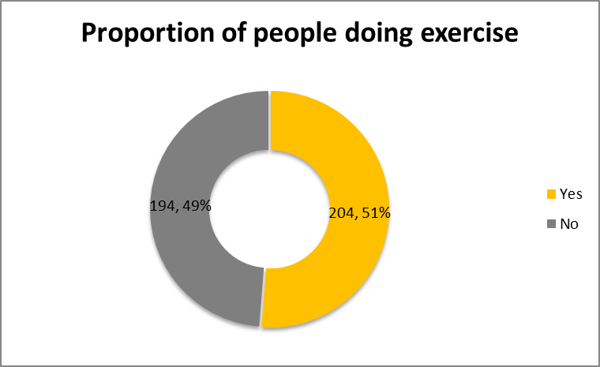
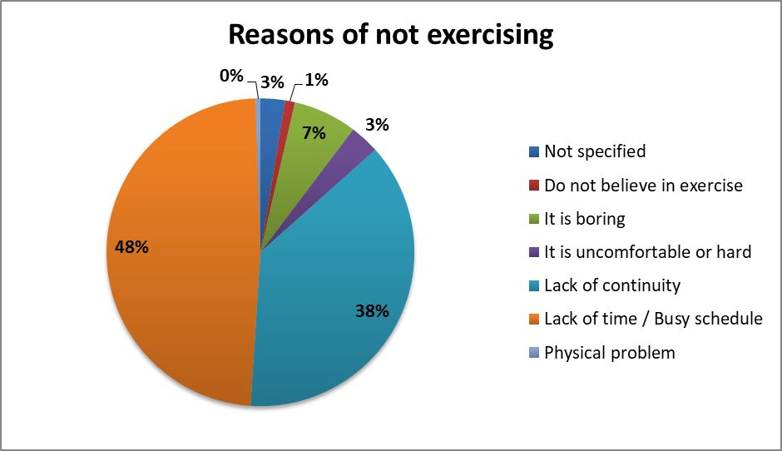
Comment :
We can see that proportion of people who exercise is nearly equal to the proportion of people who do not exercise.
Comment :
It seems that, most of the people do not exercise due to lack of time or lack of continuity in exercise.
While 7% of the people who do not exercise feels that exercise is boring and, to some exercise is uncomfortable or hard.

Slide 13
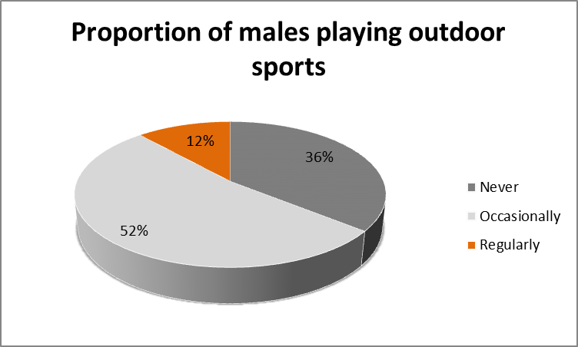
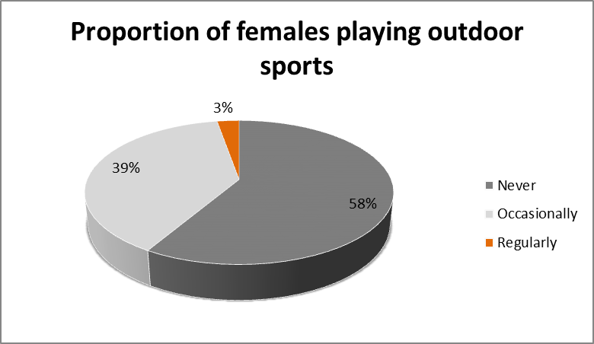
Comment :
We can see that more number of males prefer to play outdoor sports occasionally.
Around one third of males never play outdoor sports.
Only 12% of the males play outdoor sports on a regular basis.
Comment :
It seems that more than half of the females never play outdoor sports.
Around one third of the females occasionally play outdoor sports.
Just 3% of the females go for the outdoor sports on a regular basis.

Slide 14
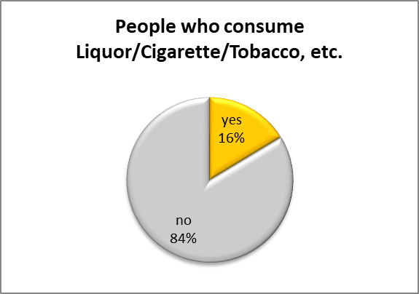
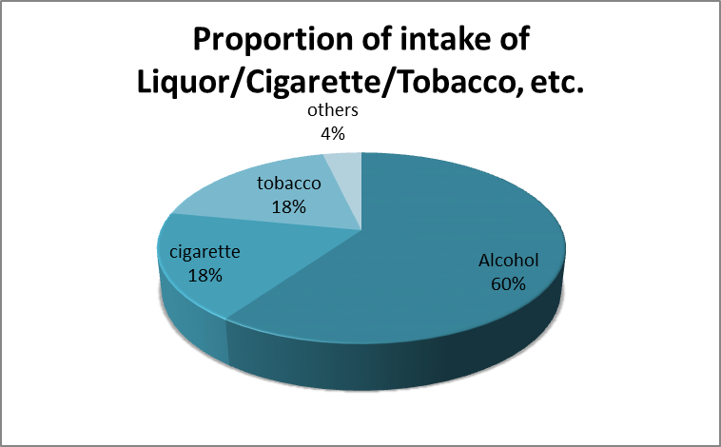
Comment :
16 % of people consume liquor or cigarette or tobacco, etc.
Comment :
Most people consume alcohol, and subsequently, some people consume cigarettes or tobacco out of those who intake any of them.

Slide 15
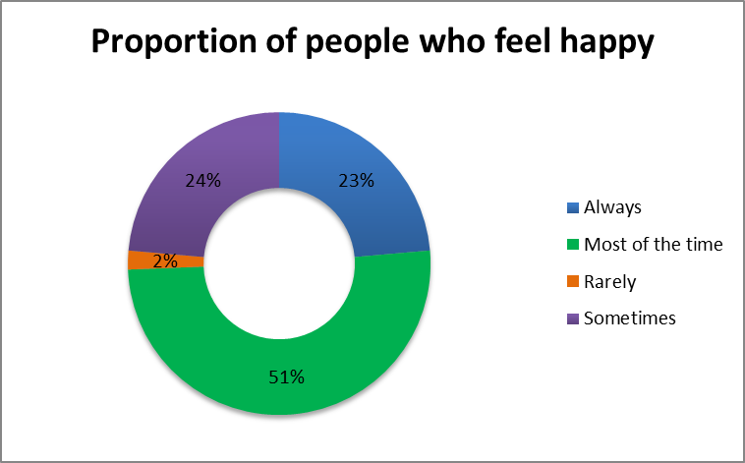
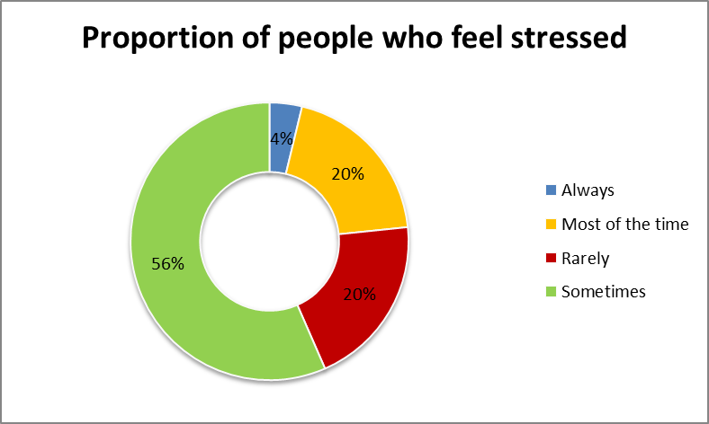
Comment :
Most of the people feel happy most of the times, but some people feel happy sometimes or rarely.
Comment :
Most of the people feel stressed sometimes, but one fourth of the people feel stressed everytime or most of the times.

Slide 16
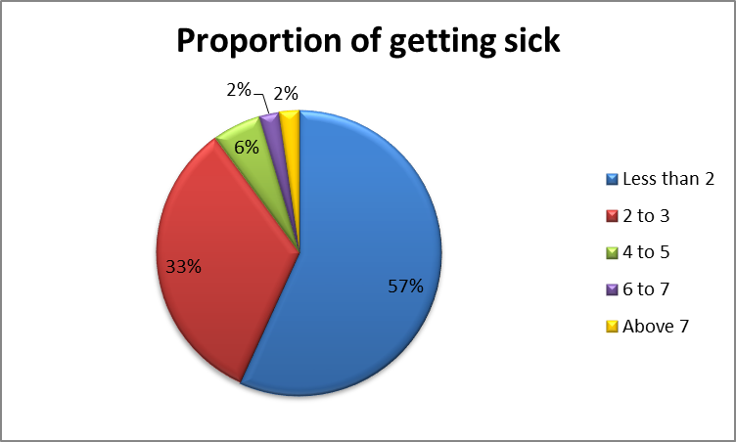
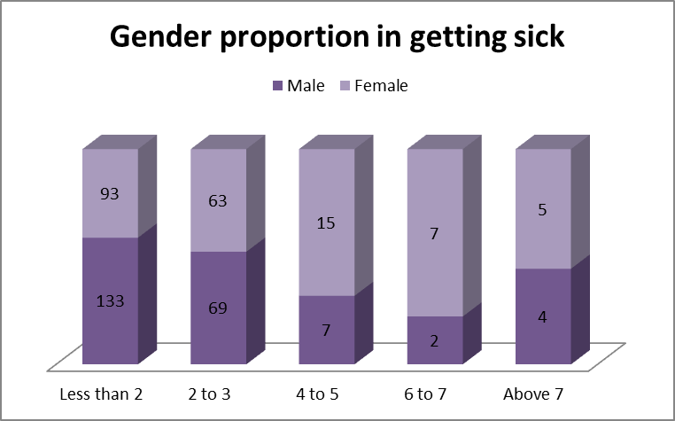
Comment :
Most of the people get sick 2 to 3 times in 6 months.
Very few people get sick more than 5 times in 6 months.
Comment :
It seems that more males get sick as compared to females for less than 4 times in 6 months.
More females get sick as compared to males for more than 4 times in 6 months.

Slide 17
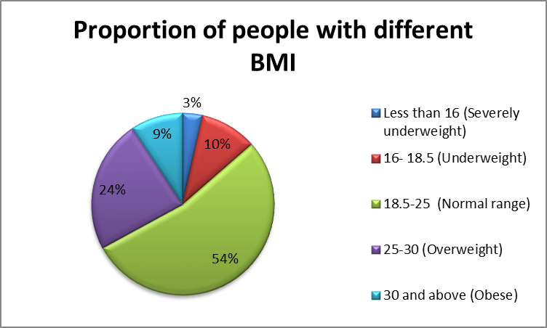
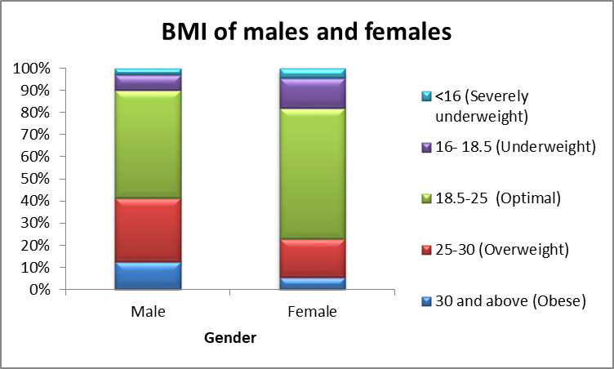
Comment :
Almost 54% people falls under normal BMI category.
Around 13% people are either underweight or severely underweight.
One third of people are either overweight or obese.
Comment :
Almost half of the males and females have optimal BMI.
It seems that more males are overweight than the females.
More number of females falls under underweight category than the males.

Slide 18
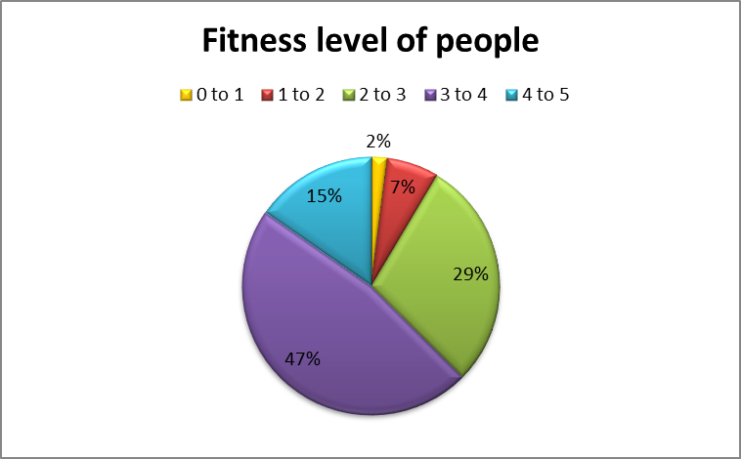
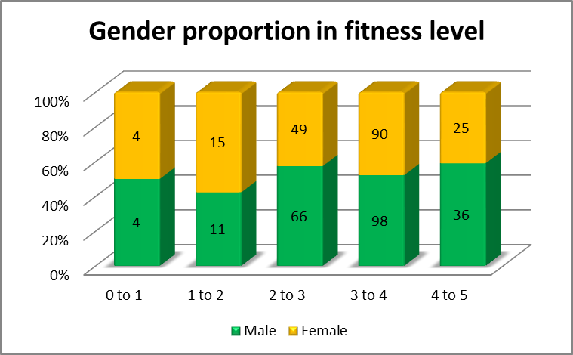
Comment :
Around half of the people rated their fitness between 3 to 4 points out of 5.
Almost one third of people think their fitness level is between 2 to 3.
Some people have rated their fitness above 4 points out of 5.
Very few people think that they are not fit.
Comment :
More males have rated their fitness between 2 to 3 or above 4 points than females.
Male and females who have rated their fitness level between 3 to 4 are equal in proportion.
More females think that they are not fit as compare to males.

Slide 19
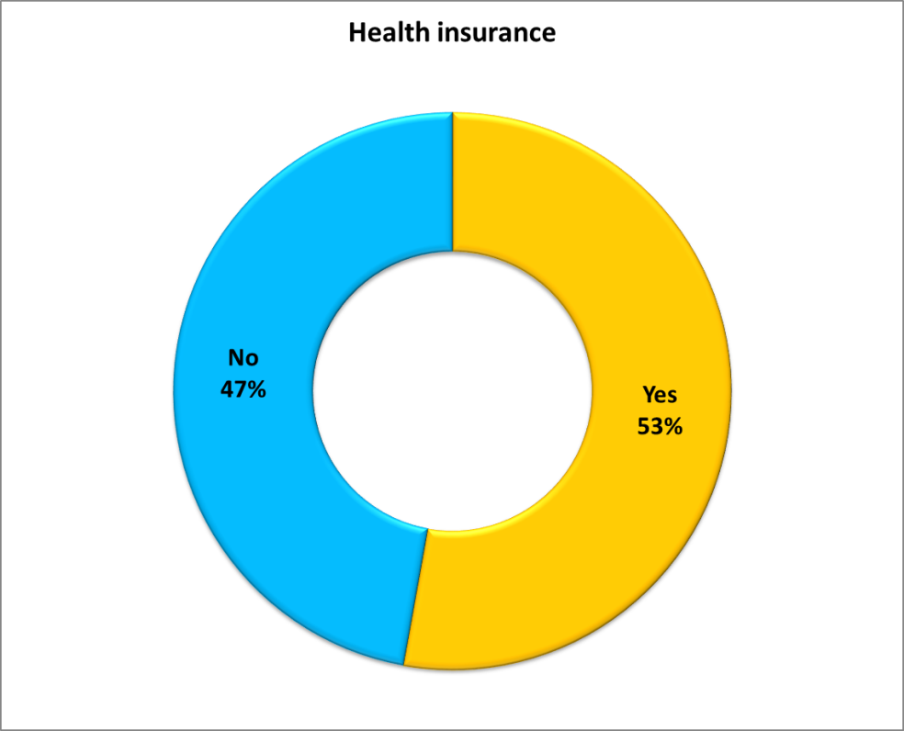
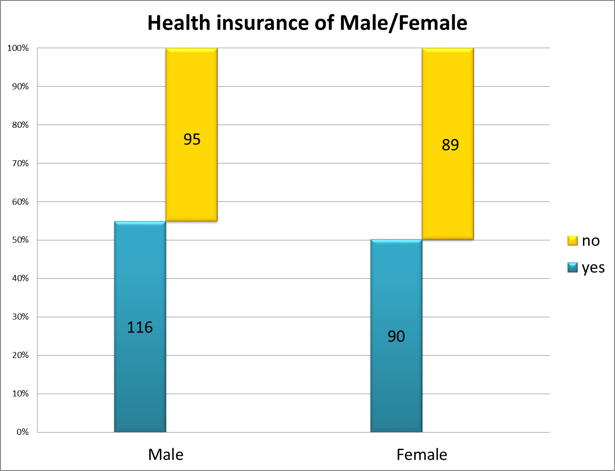
Comment :
There are more people with health insurance as compared to that without health insurance.
Comment :
It shows proportion of having health insurance in male and female is approximately equal.

Slide 20
Data Analysis Techniques

Slide 21
Independency Test (Chi-square test)

Slide 22
Amount of breakfast and Gender
Conclusion :
Gender(Male/Female) and Amount of breakfast (No, Sometimes, Daily(Light),Daily(Medium), Daily(High)) are dependent.
Type of food preferred and Gender
Conclusion :
Gender(Male/Female) and Food preference(Vegetarian, Non-Vegetarian, Eggetarian)are independent.

Slide 23
Proportion Test

Slide 24
Conclusion:
Proportion of males doing exercise is the same as that of females.
Proportion of males getting sick is the same as the proportion of females getting sick in 6 months.
Proportion of males eating junk food is the same as the proportion of females eating junk food in a week.
Proportion of males playing outdoor sports is not the same as that of females.
Proportion of males consuming alcohol, cigarette, tobacco, etc. is not the same as that of females.
Proportion of males feeling happy most of the time is the same as that of females.

Slide 25
Analysis of Variance (ANOVA)

Slide 26
Effect of amount of breakfast on BMI of a person
Conclusion :
Light amount of breakfast taken daily affects differently on BMI than Heavy breakfast taken daily.
Irregular breakfast affects differently on BMI than Heavy breakfast taken daily.
Light amount of breakfast taken daily affects differently on BMI than Medium breakfast taken daily.
The effect of Light breakfast taken daily and no breakfast on BMI is different from each other.

Slide 27
Effect of total time spent for exercise on BMI of a person
Conclusion :
Time spent on exercise between 30 to 45 minutes and 0 to 15 minutes affects differently on BMI of a person.
Time spent on exercise between 45 to 60 minutes and 0 to 15 minutes affects differently on BMI of a person.
Time spent on exercise between More than 60 minutes affects BMI differently than time spent between 0 to 15 minutes.
The effect on BMI of having no exercise and exercise done for less than 15 minutes daily is different from each other.

Slide 28
Effect of total time spent for exercise on fitness of a person
Conclusion :
Time spent on exercise between More than 60 minutes affects the fitness of a person differently than time spent between 0 to 15 minutes.
The effect on the fitness of a person due to having no exercise and daily exercise is different from each other.
Effect of amount of breakfast on fitness of a person
Conclusion :
The amount of breakfast taken has the same effect on fitness of a person.

Slide 29
Effect of type of food preferred on BMI of a person
Conclusion :
All the food types has same effect on BMI of a person.
Effect of type of food preferred on fitness of a person
Conclusion :
Vegetarian and Non-vegetarian food has different effect on the fitness of a person.

Slide 30
Linear Regression

Slide 31
Fitness of a person due to different factors
Conclusion :
We can see that, 23% of the variation in fitness of a person is due to BMI, intake of junk food, stress level, exercise, and playing outdoor sports.
Sleep hours does not significantly affect the fitness of a person.

Slide 32
Logistic Regression

Slide 33
Presence of medical condition due to different factors
Conclusion :
84% times, the model is able to tell correctly that if a person has any medical condition or not.
Exercising helps to reduce the risk of having any medical condition.
Having a daily breakfast reduces the risk of developing any medical condition as compare to having no breakfast or irregular breakfast.
An aged person, a person taking higher number of meals per day, a person feeling stressed, or a person consuming tobacco/alcohol have higher chance of developing a medical condition.

Slide 34
Values motivating to buy health insurance
Conclusion :
66% times, the model correctly predicts if a person will buy a health insurance or not.
A person will buy a health insurance if the person has annual income more than 8 lac/annum, or the person is aged.
The chance that a person with annual income less than 8 lac/annum, good fitness level, or medical condition will buy a health insurance is low.

Slide 35
Reasons behind stress of a person
Conclusion :
78% times, the model correctly predicts if a person is feeling stressed or not.
Presence of any medical condition, more working hours, frequent sickness, or intake of junk food are the reasons behind the stress of a person.
A male person or an aged person seems to have less stress.
Exercising, more sleep hours, consuming alcohol/tobacco seems to help to reduce the stress level of a person.

Slide 36
Deep Neural Networks

Slide 37
Features affecting the health of a person
Conclusion :
72% times, the neural network correctly predicts if a person is healthy or not. (a person is healthy if fitness level > 3.5)
Features affecting happiness of a person
Conclusion :
75% times, the neural network correctly predicts if a person stays happy or not.

Slide 38

Thank You..!

